Slide 1
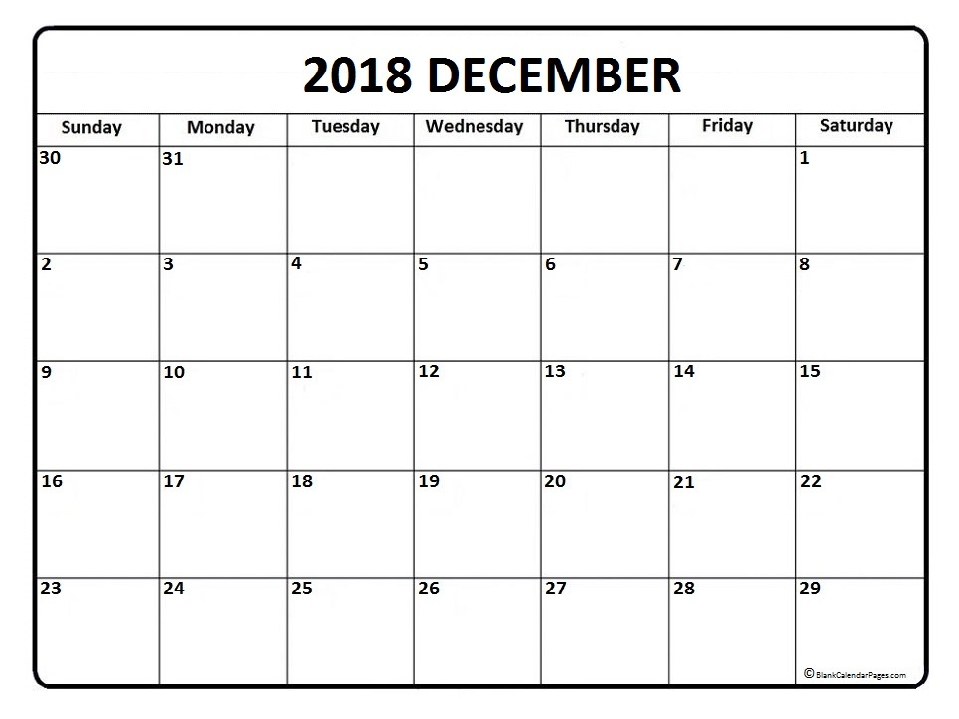

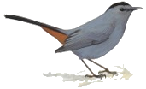





7:30am
Field Trip Brookville Lake
7:30-9pm
Program LCNB Oxford
First day of winter
Merry Christmas

Slide 2
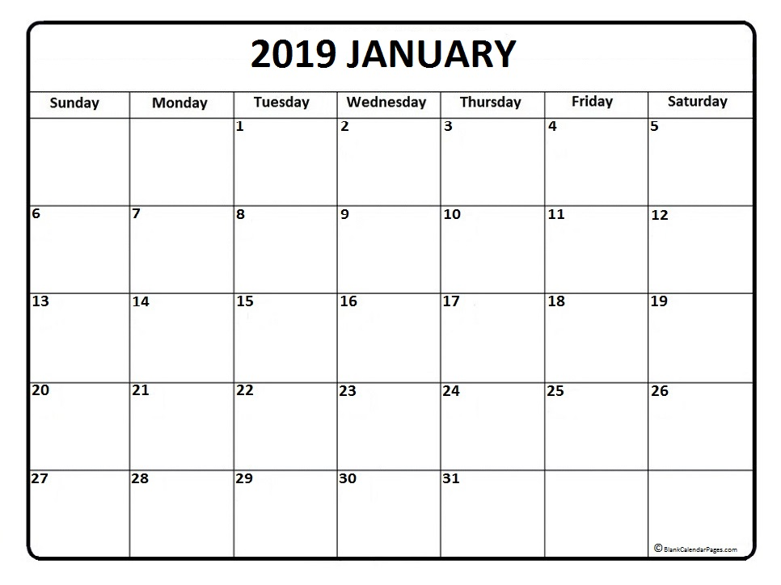
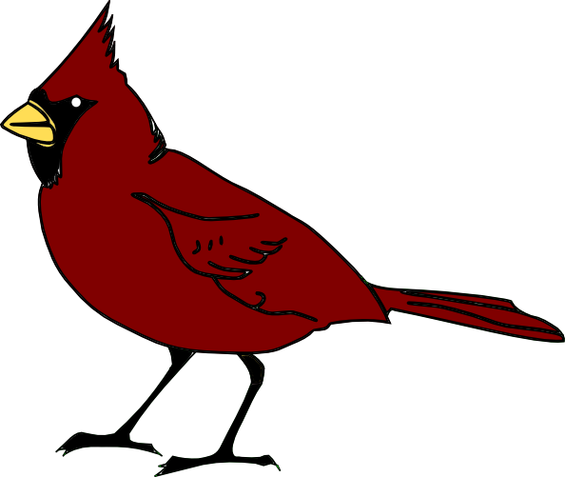

10am
7-9pm
Field trip Cincinnati Zoo
Board meeting host Gail Reynolds

Slide 3
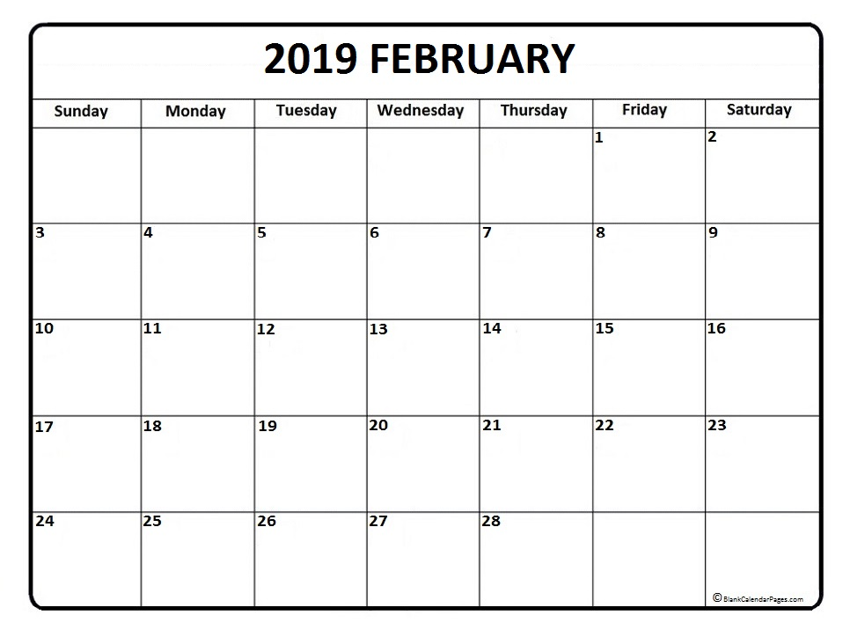

7:30-9pm
Program LCNB Oxford
7:30am
Field trip Whitewater SP
7-9pm
Board meeting
host Hardy Eshbaugh

Slide 4
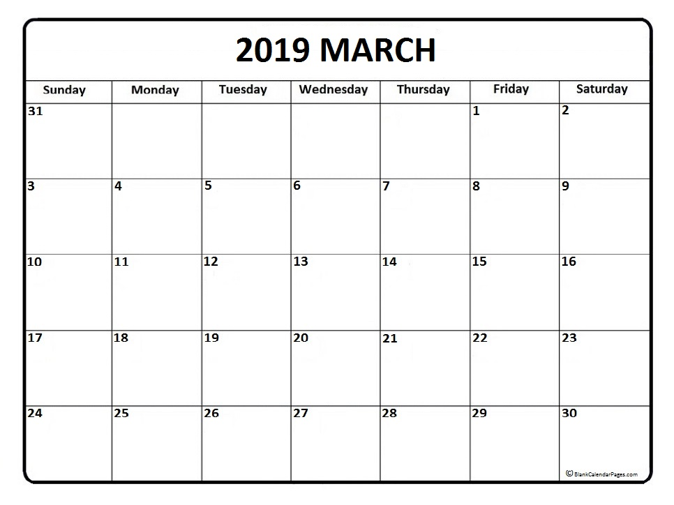
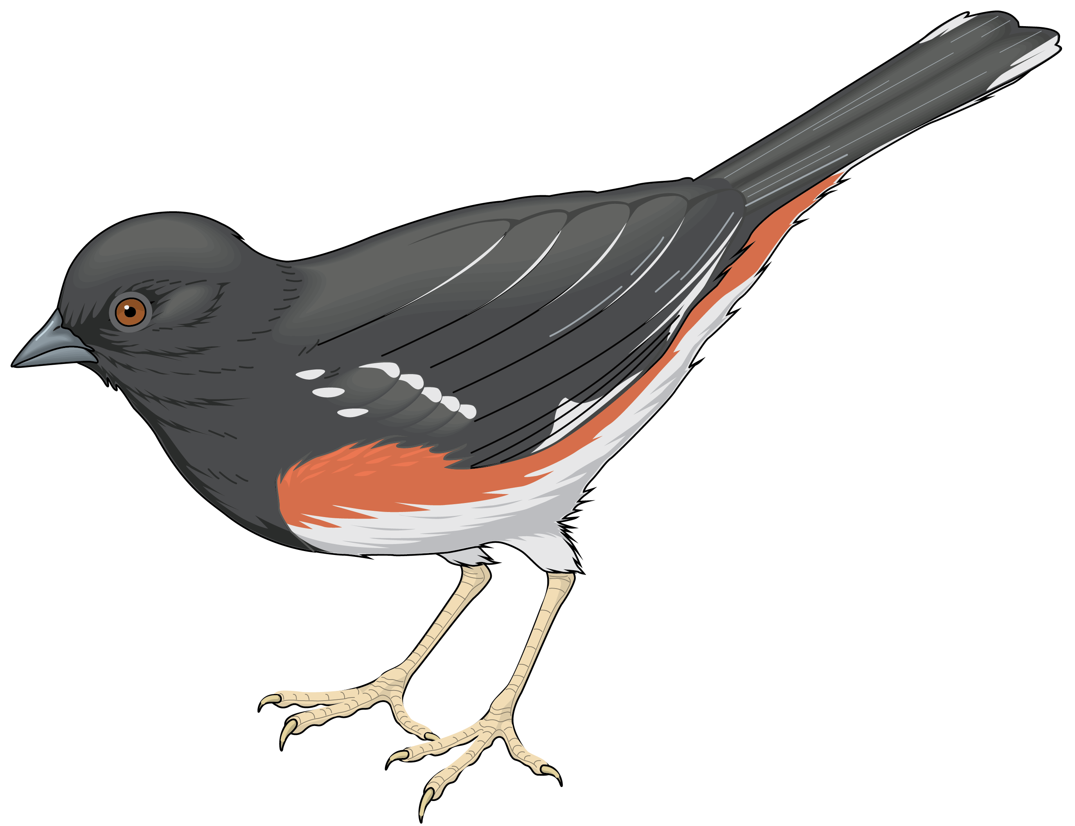

7:30-9pm
Program LCNB Oxford
7:30am
Field trip
Spring Valley WA
First day of spring
7-9pm
Board meeting host Jim Michael

Slide 5
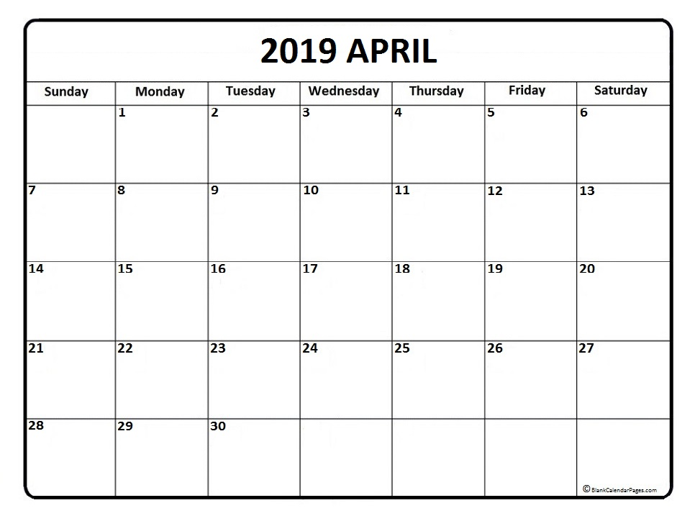
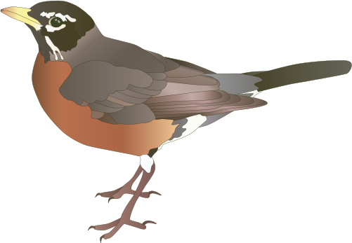








Deadline to submit articles for spring newsletter
3-5pm
3-5pm
Art drop-off OCAC Art Ed Room
Art drop-off OCAC Art Ed Room
7:30-9pm
12-5PM
Program LCNB Oxford
Art Exhibit OCAC North Parlor
7:30-9pm
Warbler Refresh Chisholm Metropark
7-9pm
3-5pm
10am-12pm
Board meeting
Art pick-up OCAC Art Ed Room
Big Woods Volunteer Day
Earth Day
Art pick-up 3-5pm
8am
Field trip Hunter/Huffmeier Property

Slide 6
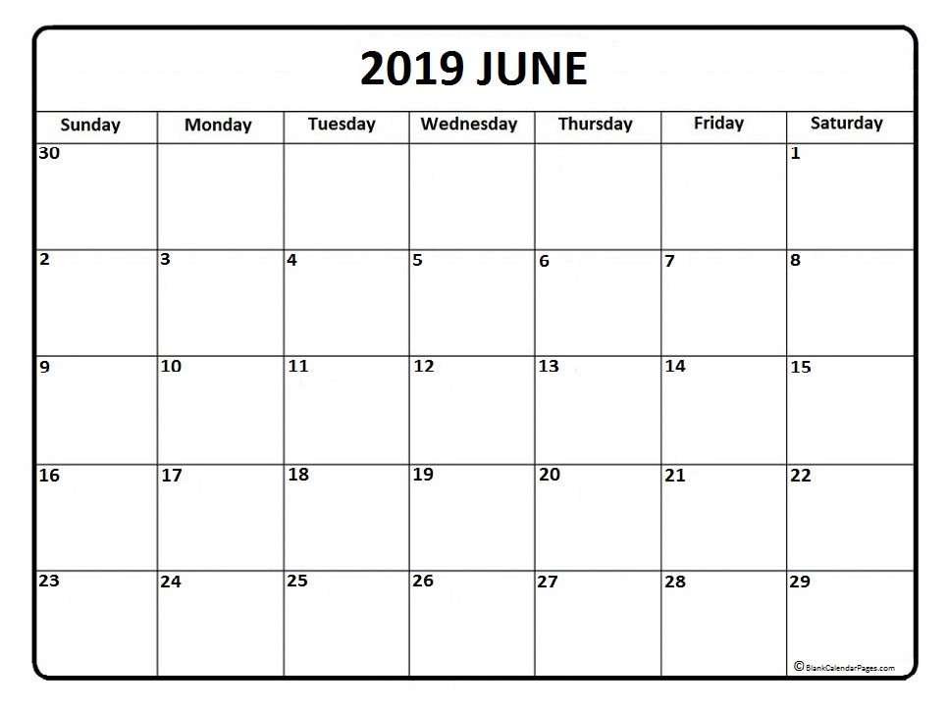
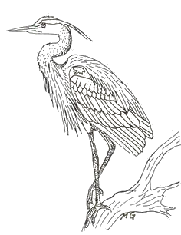

Ohio Council of Audubon Chapters

Slide 7
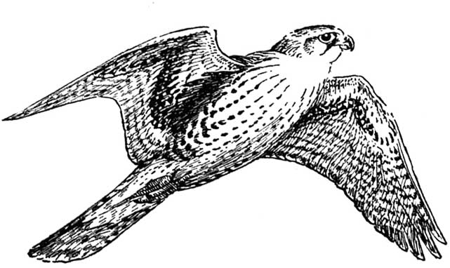
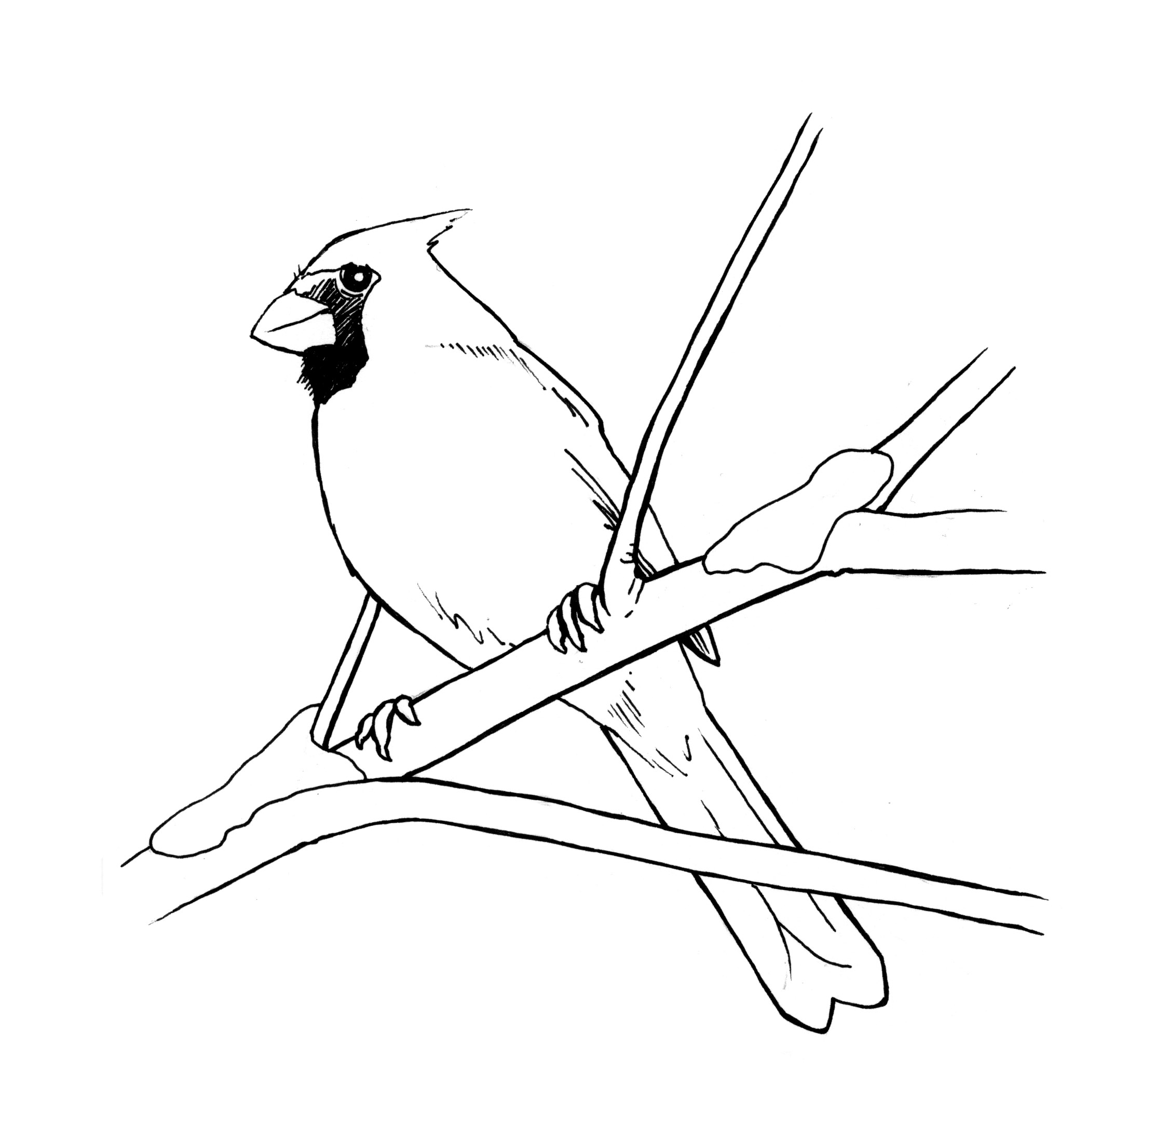
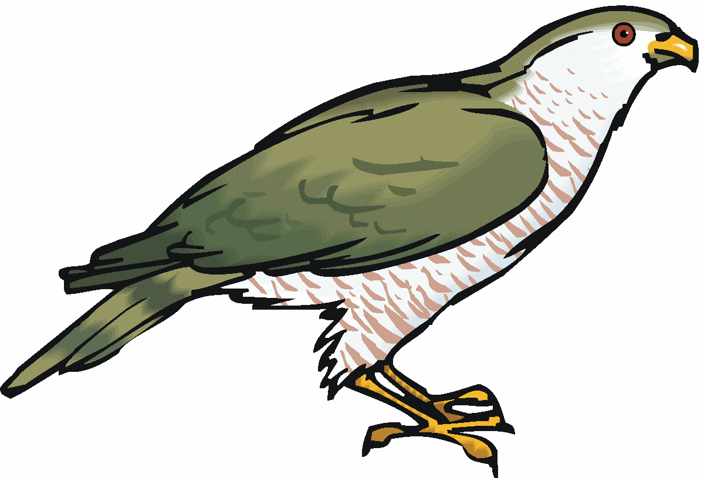



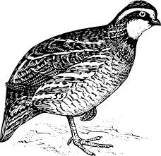
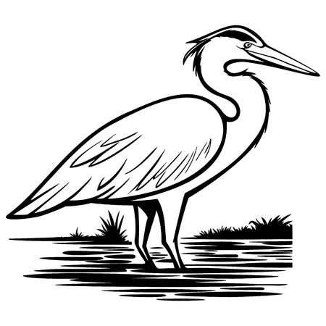
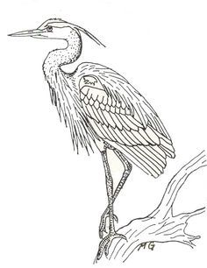
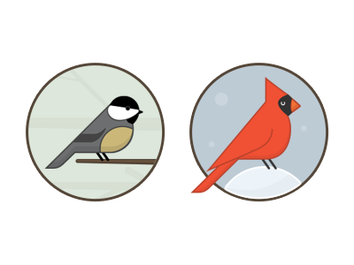
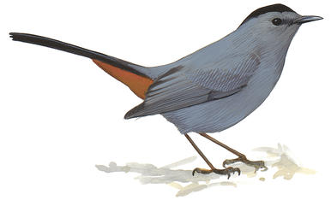
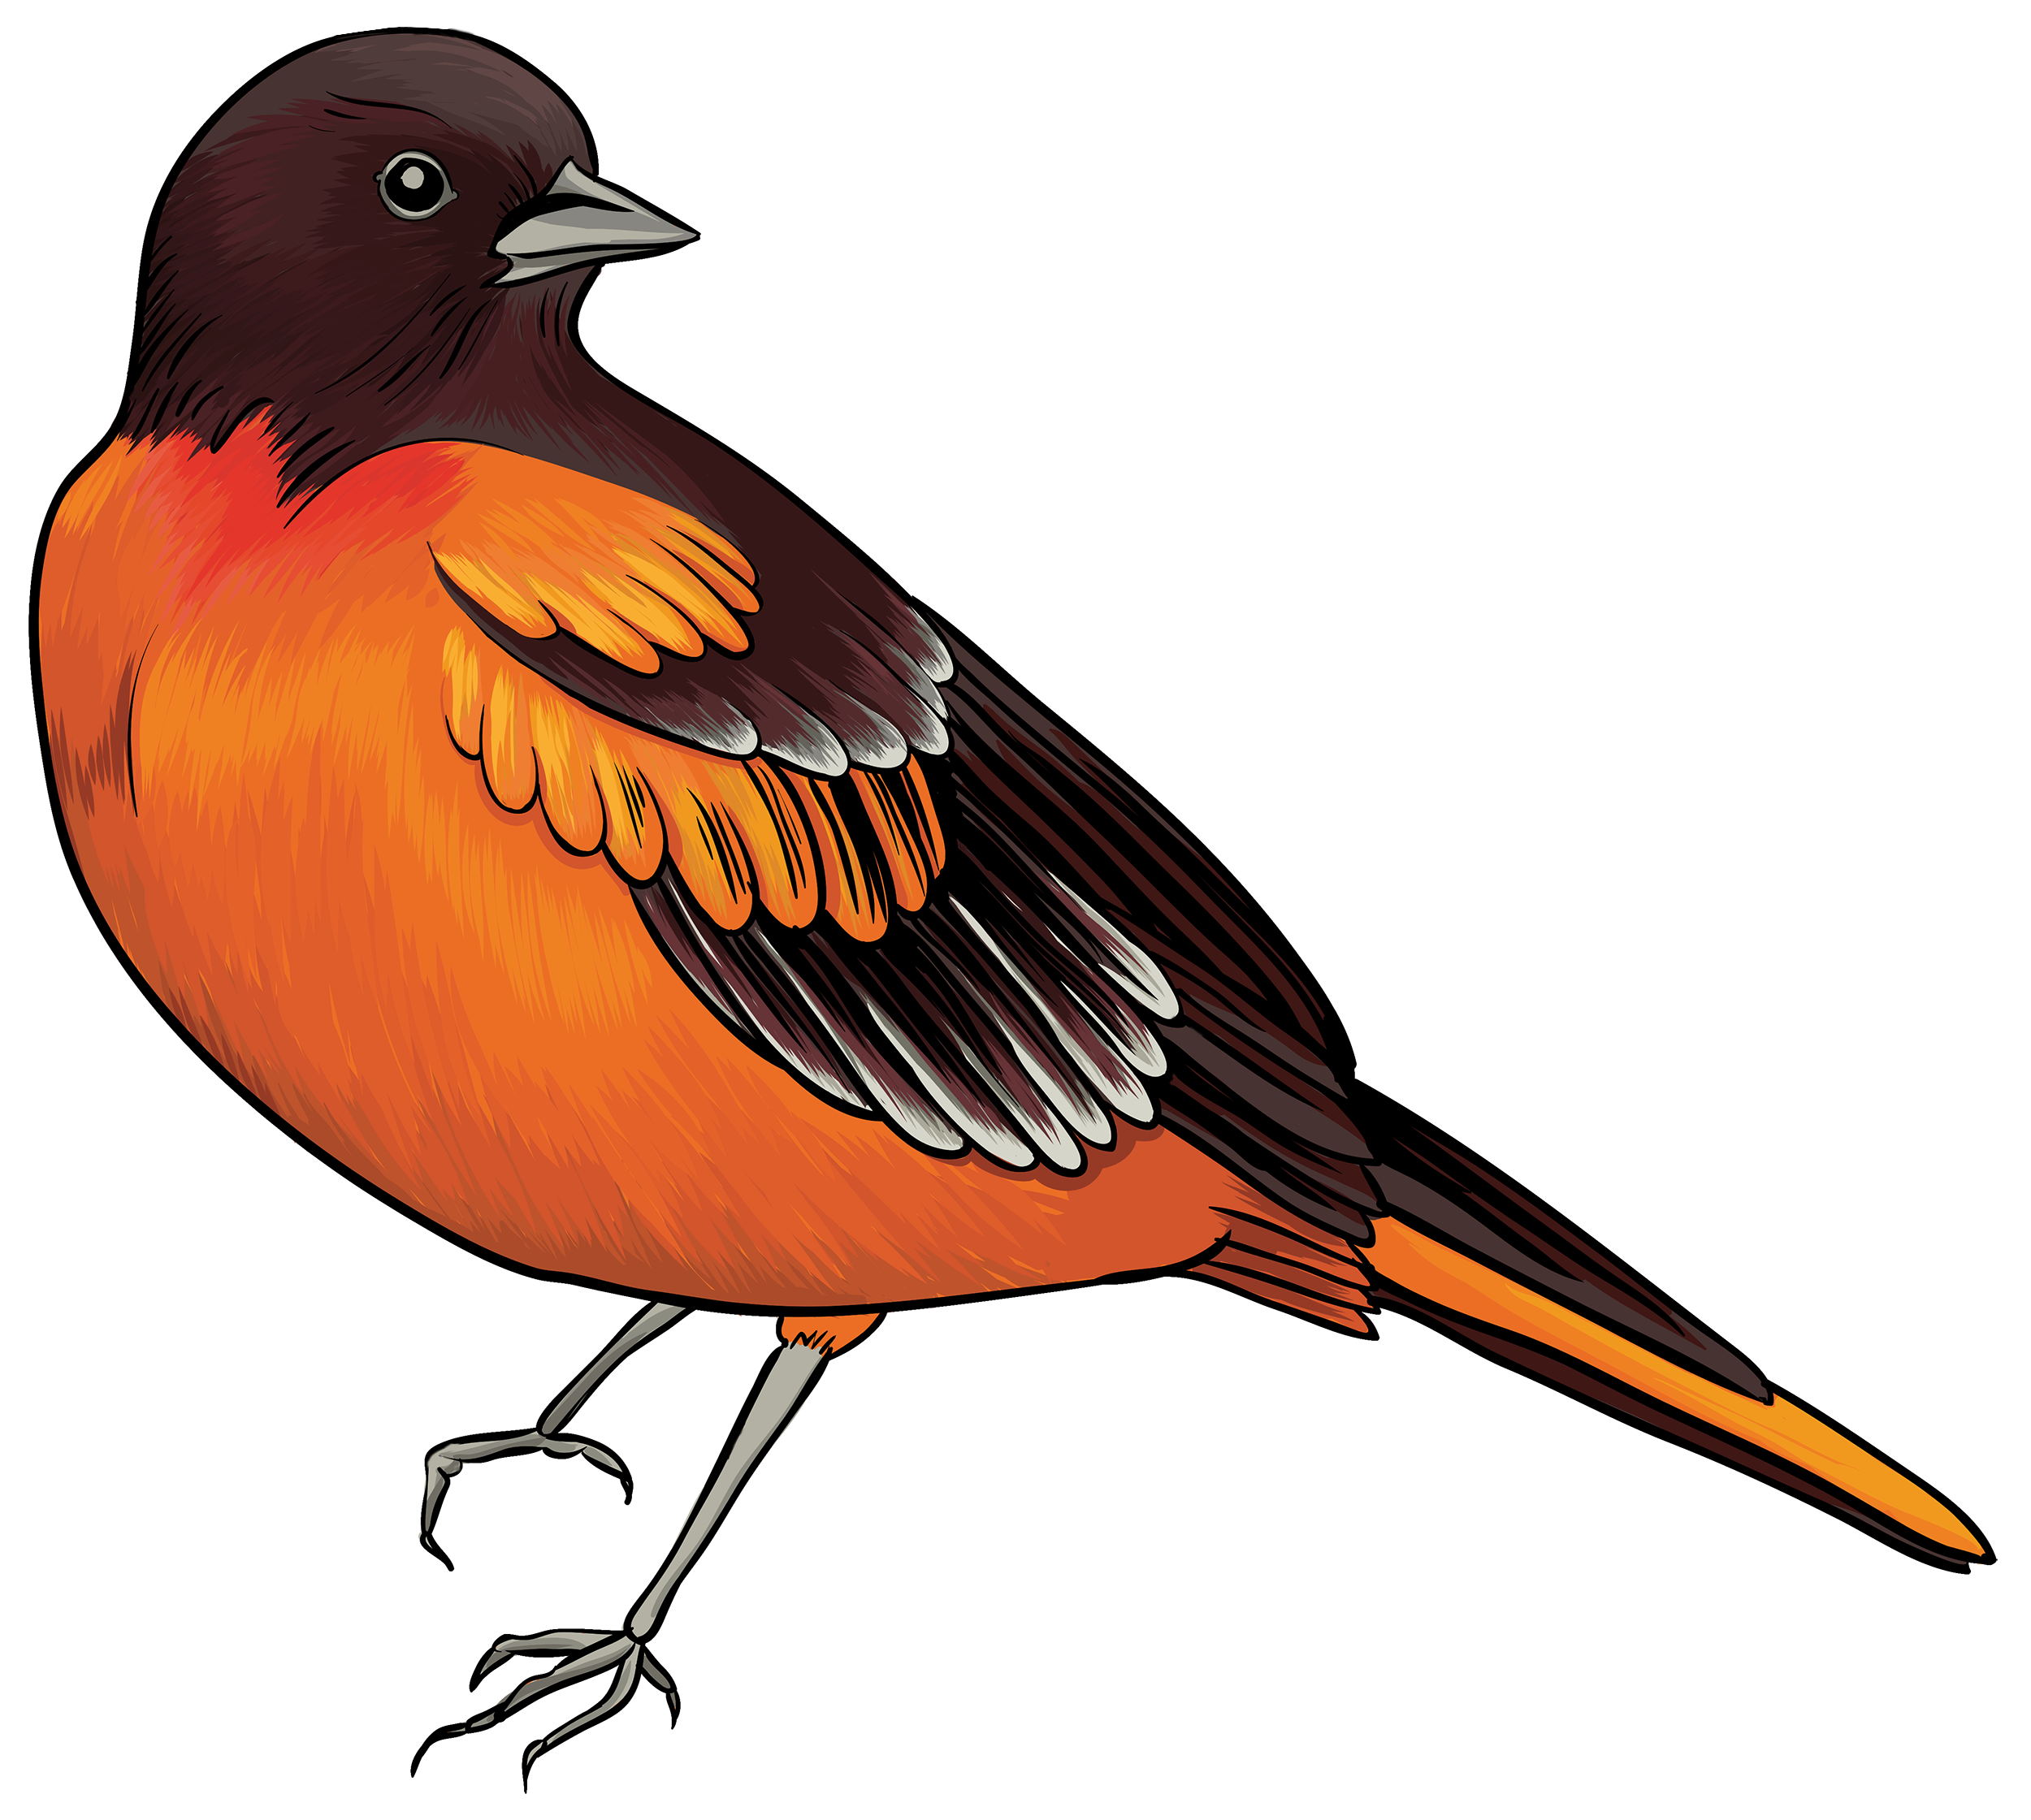


Slide 8
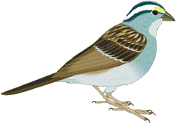
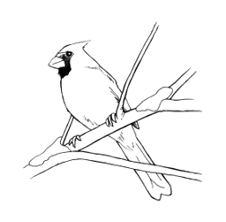

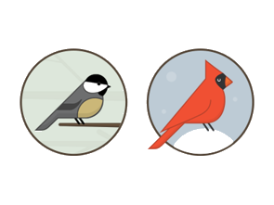


Slide 9
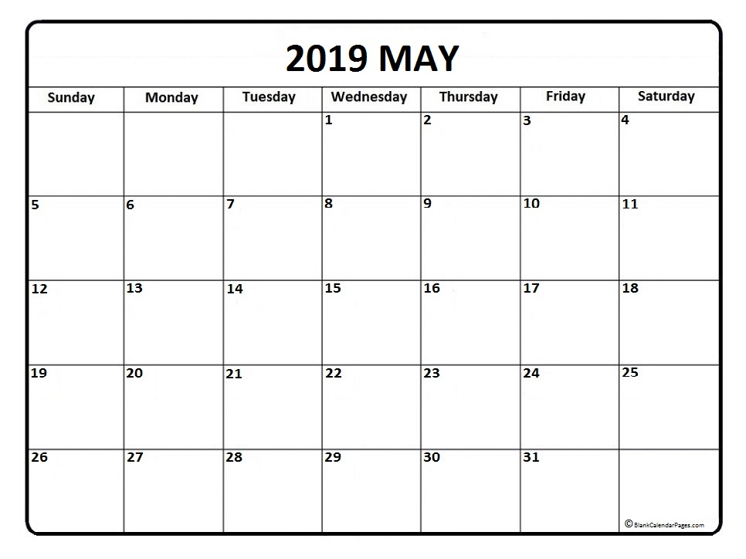
7-8pm
7-8pm
COAC Board Conference Call
COAC Board Conference Call
7:30-9pm
Program LCNB Oxford
7-8pm
COAC Board Conference Call

Slide 10
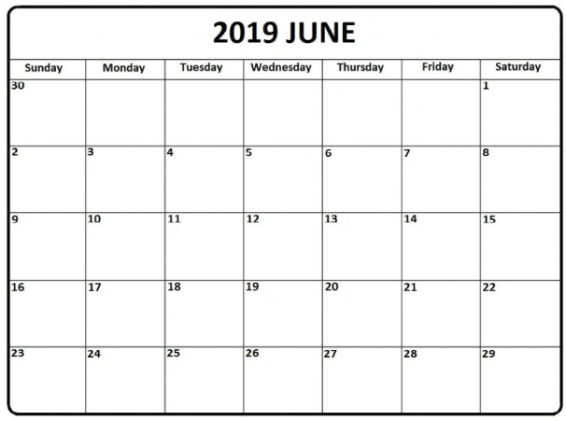

8am
Field trip Hunter/Huffmeier Property
TBA
7-8pm
7-8pm
Ohio Council of Audubon Chapters Summer Meeting
COAC Board Conference Call
COAC Board Conference Call
7-8pm
COAC Board Conference Call

Slide 11
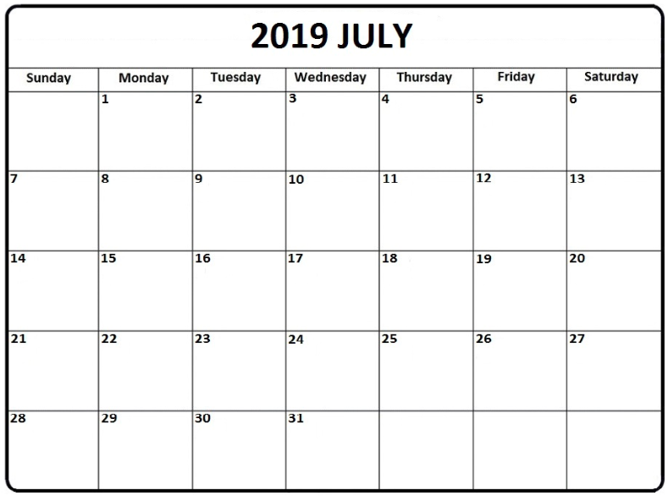
7-8pm
7-8pm
COAC Board Conference Call
COAC Board Conference Call
7-8pm
COAC Board Conference Call

Slide 12
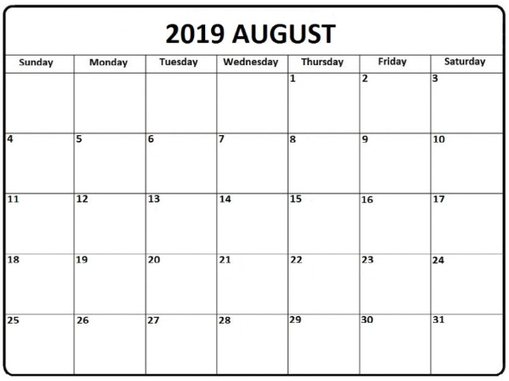
Deadline to submit articles for fall newsletter
7-8pm
7-8pm
COAC Board Conference Call
COAC Board Conference Call
7-8pm
COAC Board Conference Call

Slide 14
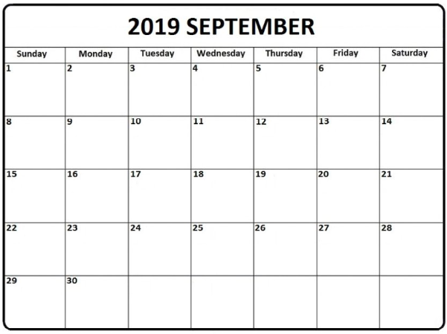
7-8pm
7-8pm
COAC Board Conference Call
COAC Board Conference Call
TBD
7:30-9pm
Program LCNB Oxford
COAC Board Conference Fall meeting
7-9pm
Board meeting host TBD

Slide 15
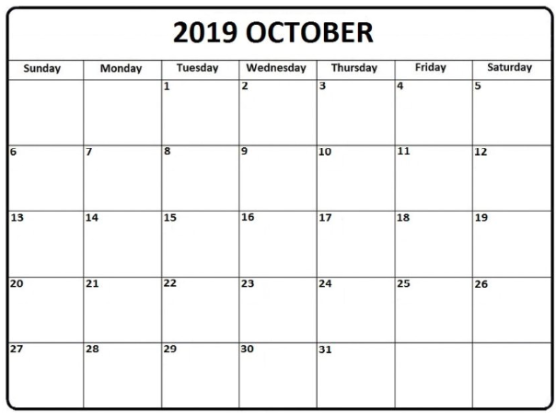
7:30-9pm
Program LCNB Oxford
7-9pm
Board meeting host TBD

Slide 16
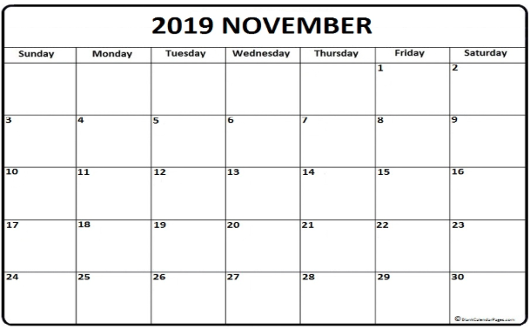
TBD
Hefner Lecture Series TBD
7:30-9pm
Program LCNB Oxford

Slide 17
